Slide 1
Designing Experiments to Measure Incrementality on Facebook
C.H. Bryan Liu, Elaine M. Bettaney, Benjamin Paul Chamberlain ASOS.com & Imperial College London @liuchbryan
Notes:
With thanks to Marcus Ojala and Lauri Kovanen.
Paper: https://arxiv.org/pdf/1806.02588.pdf
Code: https://github.com/liuchbryan/fb_lift_study_design

Slide 2

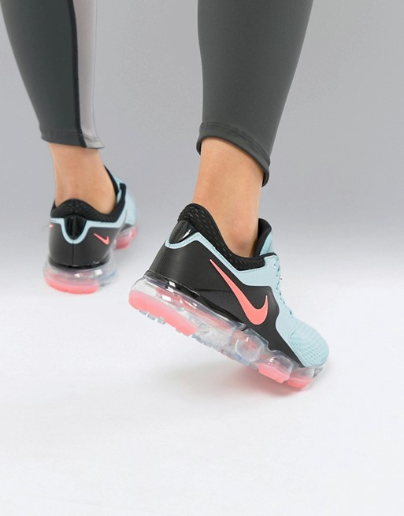


Facebook advertising has risen dramatically in importance
In 2017, $204bn was spent on online advertising [1].
Amongst that, $40bn was spent with Facebook targeting 2.13bn monthly active users [2].
We find advertising on Facebook allows us to continue inspire fashion-loving 20-somethings to express their best selves and achieve amazing things.
Notes:
[1] Zenith. 2018. Advertising Expenditure Forecasts March 2018. (2018). https://www. zenithmedia.com/product/advertising-expenditure-forecasts-march-2018/
[2] Facebook Inc. 2018. Facebook Reports Fourth Quarter and Full Year 2017 Results. (2018). https://investor.fb.com/investor-news/press-release-details/2018/ Facebook-Reports-Fourth-Quarter-and-Full-Year-2017-Results/default.aspx

Slide 3
The need to measure incrementality
Over time, we moved away from measuring our ad campaign’s performance using ROI / ROAS in favour of incrementality.
This allows a fairer evaluation of a campaign’s performance, and hence enabling better attribution.
Notes:
Illustration source: https://missyward.com/affiliate_marketing/affiliate-marketing-smart-merchants-road-to-incrementality-and-roi/

Slide 4
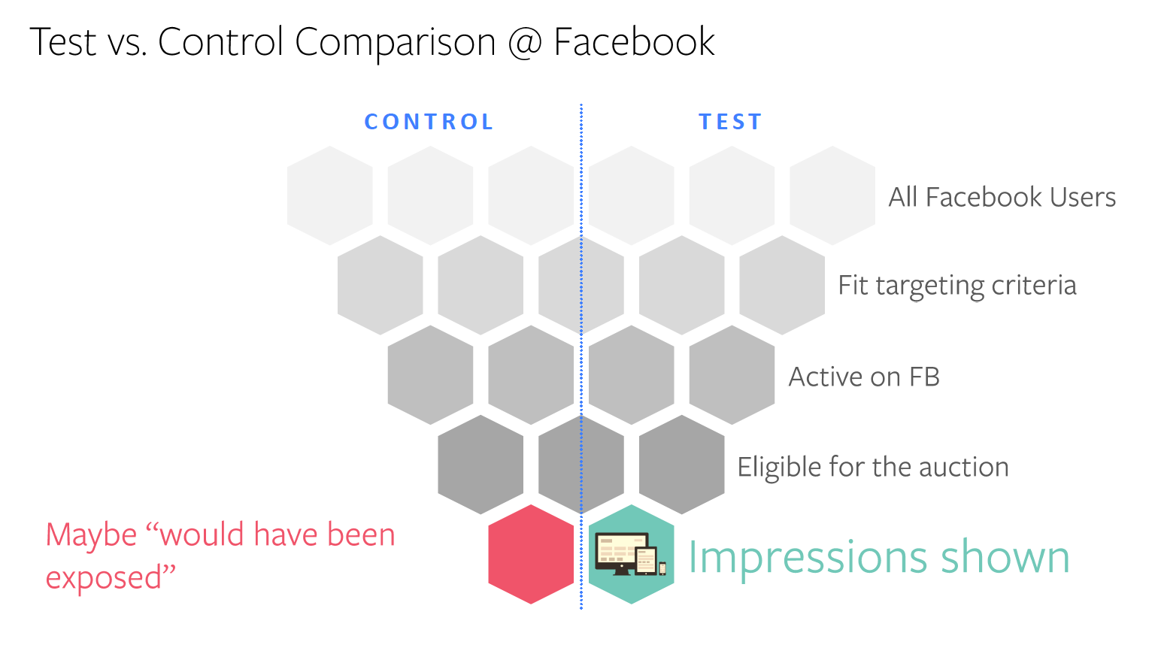
They offer incrementality measurement via lift studies
A controlled experiment where the target population is split into two:
Test group: Adverts shown
Control group: Adverts not shown
Difference in a metric (e.g. total sales, number of app installs) between the test and control groups is the incrementality of the campaign.
Notes:
Illustration source: Facebook

Slide 5

ISN’T THAT JUST AN A/B TEST?
BRYAN LIU
_{2016 ASOS ltd} _{all rights reserved}

Slide 6
A/B test with a few twists
An unreached audience
Not every one in the test group gets to see an ad!
A scaled control group
The group size of the control group is scaled to match that of the test group for a meaningful comparison.
A Facebook-controlled test/control split
Advertisers have no access to user-level data for data protection reasons - only the aggregated level result is reported.
Notes:
Reached/unreached audience - The existence of the unreached audience can be due to the advertiser losing every bid on a particular user, or when the bid is won, the ad is shown off screen. As shown later, the unreached audience does not move the primary test metric, but they do contribute extra variance around the given value.
Scaled control group - If the control group is scaled up, the variance increases. Likewise the variance decreases if the control group is scaled down.
Facebook-controlled test/control split – This means usual statistical techniques like bootstrap/permutation test is not available.

Slide 7
Comparing marketing strategies via multi-cell tests
Facebook can split the target population into multiple cells. Different campaigns + test-control splits can be run in each.
These can be used to compare strategies where the target audience exhibits a selection bias [3] (e.g. comparing campaigns that vary the bid size based on customer lifecycle).
We are interested in measuring the difference between incrementalities attained by the campaigns. This is not reported by Facebook.*
Notes:
[3] C.H. Bryan Liu and Benjamin Paul Chamberlain. 2018. Online Controlled Experiments for Personalised e-Commerce Strategies: Design, Challenges, and Pitfalls. arXiv preprint arXiv:1803.06258 (2018).
* While Facebook reports the incrementality of each individual cell in a multi-cell lift study, they do not report if the incrementality difference is statistically significant, nor advise on the statistical power or sample size required to design the experiment.

Slide 8
The current gap in literature
Advertising on Facebook
Controlled Experiment Design
Gordon et al. [4]
Notes:
Illustation: https://www.illustrationsource.com/stock/image/510019/man-with-ladder-facing-friend-across-canyon/?&results_per_page=1&detail=TRUE&page=1
[4] Brett R. Gordon, Florian Zettelmeyer, Neha Bhargava, and Dan Chapsky. 2017. A Comparison of Approaches to Advertising Measurement: Evidence from Big Field Experiments at Facebook. (2017). http://www.kellogg.northwestern.edu/faculty/gordon_b/files/fb_comparison.pdf White paper.

Slide 9
AGENDA
How does Facebook calculate incrementality and lift? (A quick overview of Gordon et al. [4])
How can we estimate the test power and sample size required to run a Facebook lift study?
Can we generalise the test power and sample size required calculations to a multi-cell study?
Notes:
[4] Brett R. Gordon, Florian Zettelmeyer, Neha Bhargava, and Dan Chapsky. 2017. A Comparison of Approaches to Advertising Measurement: Evidence from Big Field Experiments at Facebook. (2017). http://www.kellogg.northwestern.edu/ faculty/gordon_b/files/fb_comparison.pdf White paper.

Slide 10
Calculating Incrementality & Lift in a Facebook Lift Study
A Quick Overview

Slide 11
How does Facebook do it?
We use # conversions as the running example, though the calculations apply to other metrics.

Slide 12
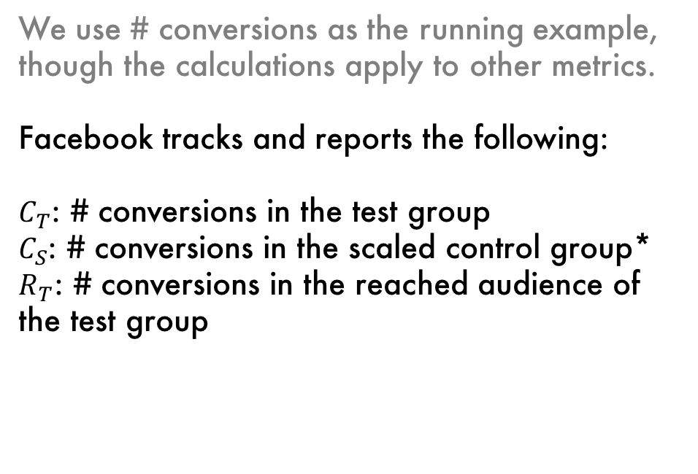
How does Facebook do it?
We use # conversions as the running example, though the calculations apply to other metrics.
Facebook tracks and reports the following:
$C_{T}$: # conversions in the test group
$C_{S}$: # conversions in the scaled control group*
$R_{T}$: # conversions in the reached audience of the test group
Notes:
*The control group is scaled so that the size (not necessarily the # of conversions) of the groups match.

Slide 13
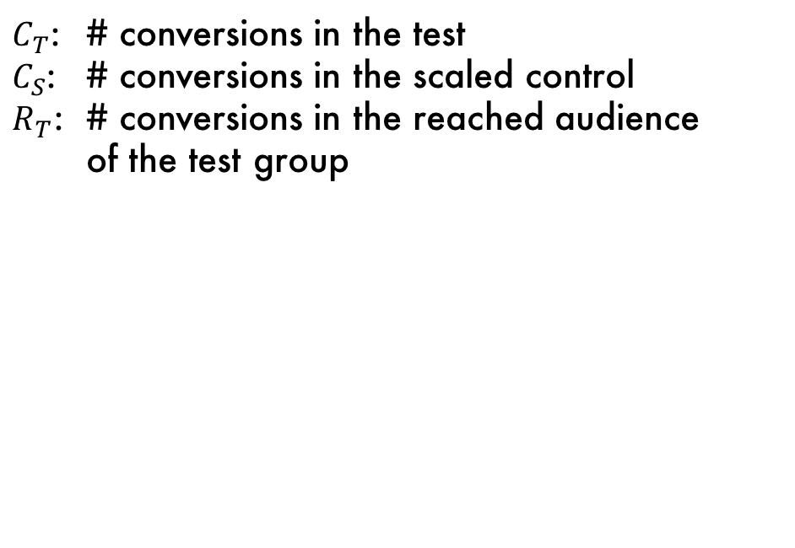
How does Facebook do it?
$C_{T}$: # conversions in the test
$C_{S}$: # conversions in the scaled control
$R_{T}$: # conversions in the reached audience of the test group

Slide 14
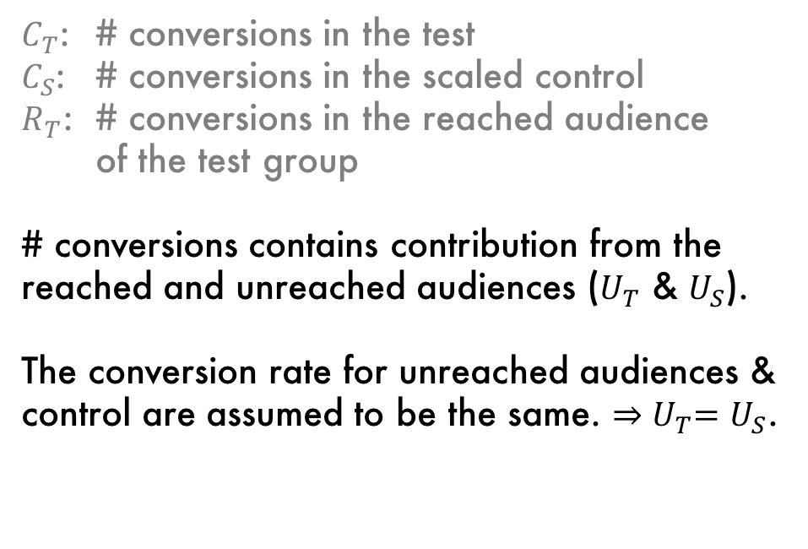
How does Facebook do it?
$C_{T}$: # conversions in the test
$C_{S}$: # conversions in the scaled control
$R_{T}$: # conversions in the reached audience of the test group
# conversions contains contribution from the reached and unreached audiences ($U_{T}$ & $U_{S}$).
The conversion rate for unreached audiences & control are assumed to be the same. ${⇒U}_{T}=U_{S}$.
Notes:
Conversion rate for unreached audiences assumed to be the same as they do not see ads.
$r$ can be defined as $R_{S}$/$U_{S}$ as the conversion rate between the two groups are assumed to be the same.

Slide 15
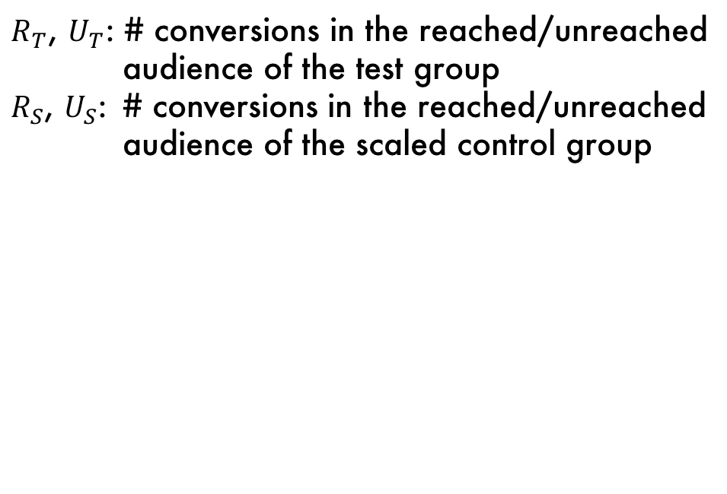
How does Facebook do it?
$R_{T}$, $U_{T}$: # conversions in the reached/unreached
audience of the test group
$R_{S}$, $U_{S}$: # conversions in the reached/unreached
audience of the scaled control group

Slide 16
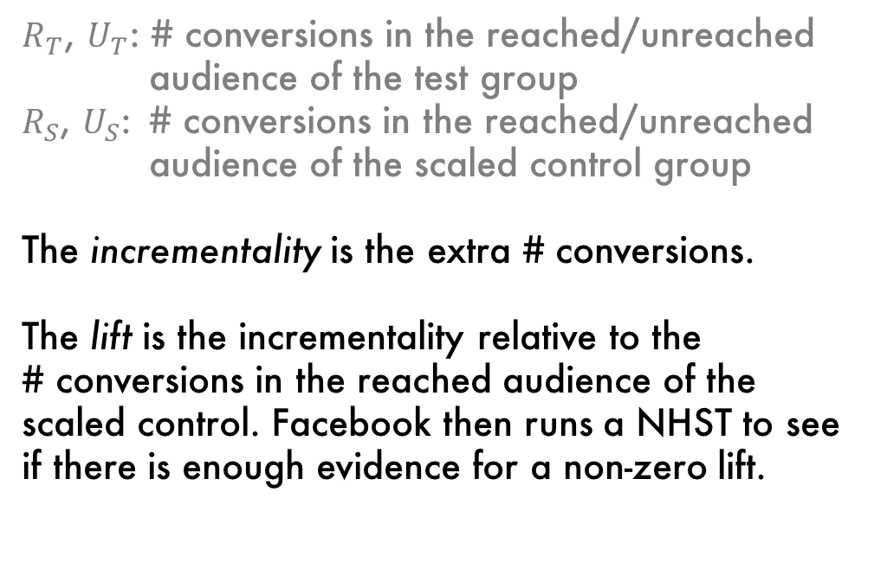
How does Facebook do it?
$R_{T}$, $U_{T}$: # conversions in the reached/unreached
audience of the test group
$R_{S}$, $U_{S}$: # conversions in the reached/unreached
audience of the scaled control group
The incrementality is the extra # conversions.
The lift is the incrementality relative to the # conversions in the reached audience of the scaled control. Facebook then runs a NHST to see if there is enough evidence for a non-zero lift.
Notes:
Note the # conversions originating from the unreached audiences in both groups does not contribute to the outcome (or mean) of the incrementality/lift of the campaign, though they contribute to the variance of the incrementality/lift, and should be taken into account when running statistical tests.
The # conversion arising from “reached” audience of the scaled control is also known as the counterfactual # conversions in Gordon et al.
NHST: Null Hypothesis Significance Testing

Slide 17
Estimating the test power & sample size required
Filling in the missing piece

Slide 18
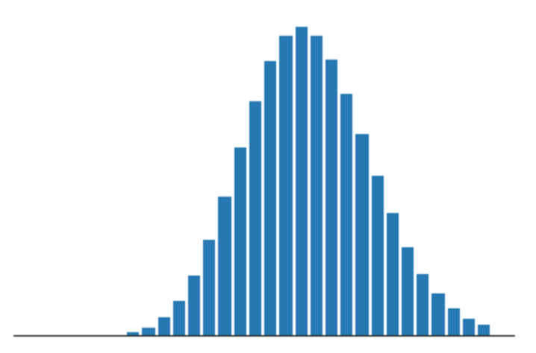
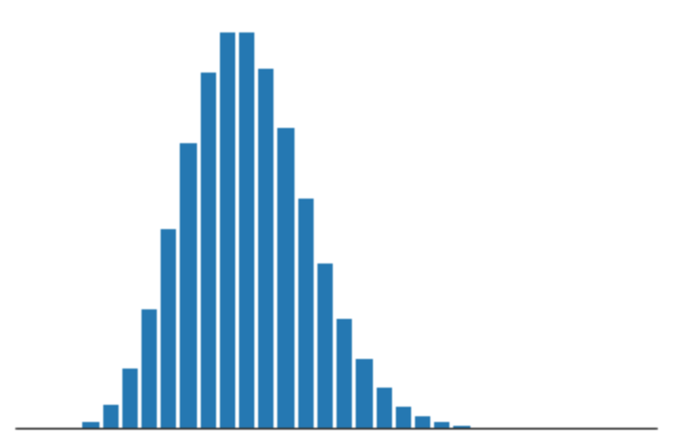
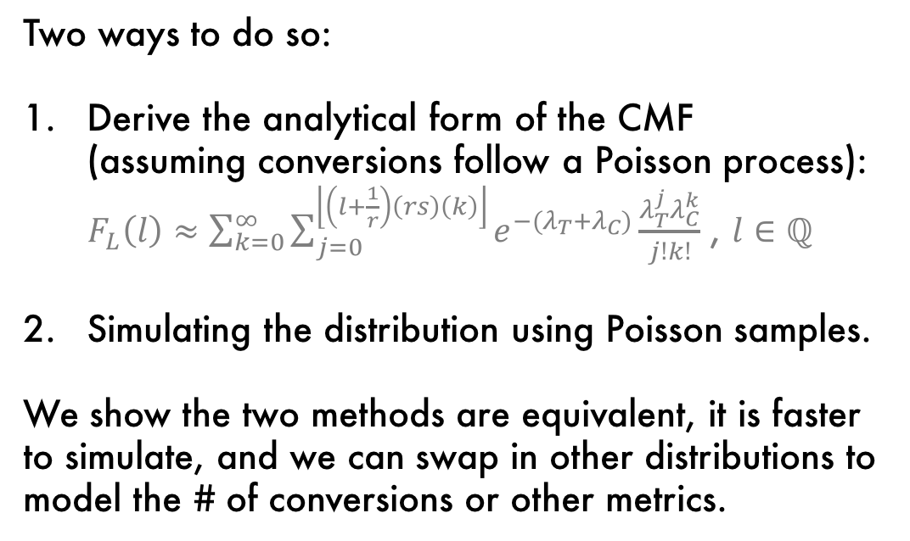
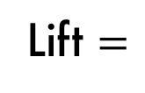
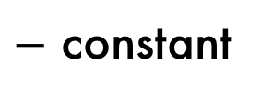
We first require the distribution of the test statistic - lift
Two ways to do so:
Derive the analytical form of the CMF (assuming conversions follow a Poisson process): $F_{L}\left(l\right)≈\sum_{k=0}^{∞}{\sum_{j=0}^{\left\lfloor \left(l+\frac{1}{r}\right)\left(rs\right)\left(k\right)\right\rfloor }{e^{−(λ_{T}+λ_{C})}\frac{λ_{T}^{j}λ_{C}^{k}}{j!k!}}}$ , $l∈ℚ$
Simulating the distribution using Poisson samples.
We show the two methods are equivalent, it is faster to simulate, and we can swap in other distributions to model the # of conversions or other metrics.
Lift $=$
$−$ constant
Notes:
For example, we can assume $C_{T}$ (total # conversions in the test group) and $C_{C}$ (total # conversions in the control group) to follow some gamma distribution if we wanted to do continuous monitoring instead of fixed-horizon NHST. This is because gammas are good conjugate distributions for Poisson likelihoods.
It is also desirable to model metrics like spend using a heavy-tailed distribution (e.g. log-normal, power-law distributions).

Slide 19
Test power
We can then estimate the test power w.r.t. a minimum detectable lift & a sample size as follow:
Derive the lift distribution under the null hypothesis, usually when expected lift = 0.
Notes:
* For Facebook lift studies, test power is dependent on the minimum detectable lift $L_{m}$, the number of expected conversions in the control group $𝔼(C_{C})$, the scaling factor relating the size of the test group to the control group $s$, and the reach $r$, which in turn depends on many variables, in particular ad spend.

Slide 20
Test power
We can then estimate the test power w.r.t. a minimum detectable lift & a sample size as follow:
Derive the lift distribution under the null hypothesis, usually when expected lift = 0.
Find the critical value, usually the 95th percentile.
Notes:
Note Facebook defaults running a two-tailed test with 90% confidence / 10% significance. Using results from a one-tailed test with 5% significance yields identical result if the ad campaign has non-negative incrementality.

Slide 21
Test power
We can then estimate the test power w.r.t. a minimum detectable lift & a sample size as follow:
Derive the lift distribution under the null hypothesis, usually when expected lift = 0.
Find the critical value, usually the 95th percentile.
Derive the distribution under the alternate hypothesis (expected lift = minimum detectable lift), and find the proportion of the distribution over the critical value.

Slide 22
Minimum sample size required
Given a target minimum detectable lift and test power (usually 80%), we can solve for the minimum sample size required using some root-finding methods.

Slide 23
Generalising to multi-cell lift studies
Same techniques, but a different test statistic

Slide 24
Comparing incrementalities
Recall we were finding the incrementality/lift of an ad campaign.

Slide 25
Comparing incrementalities
In a multi-cell lift study, we are also interested in comparing the difference between incrementalities/lifts, and see if there is statistical evidence that it is non-zero.
← Cell/Strategy A
Cell/Strategy B →
Notes:
Note due to a change in what you do to the population in the cell, the number of conversions for the reached/unreached audience of the test/control group, and hence the incrementality and lift, are very likely to be different.

Slide 26
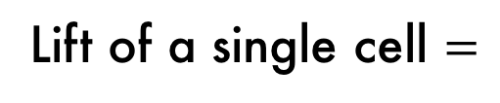
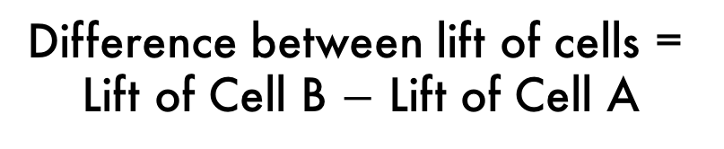
Test statistic
The difference in lift is defined as the (absolute, not relative) difference between the lift in Cell B and that in Cell A.
We simulate the distribution of the difference in lift, as it is very difficult to obtain an analytical form of the distribution.
Lift of a single cell $=$
$−$ constant
Difference between lift of cells =
Lift of Cell B $−$ Lift of Cell A

Slide 27
The test statistic distribution is different!
The variance of the test statistic will increase even if the variance within each group stays the same, as multi-cell studies have more test/control groups.
Single-cell study
Multi-cell study
Notes:
Here we assume the number of conversions (or sample size) in the control group of the single cell study is equal to the number of conversions in the Cell A control group of the multi-cell study.
The frequency density represents the number of simulations done to obtain the distributions - it has nothing to do with the sample size / number of conversions in each group featured.

Slide 28
The test statistic distribution is different!
Hence, a common pitfall in multi-cell studies is to use the test power and minimum sample size derived for single cell lift studies. Otherwise, the way to calculate test power is similar.
Single-cell study
Multi-cell study

Slide 29
SUMMARY
We went through how Facebook calculate incrementality and lift. (A quick overview of Gordon et al.)
We fill in the gap in literature by providing a test power & minimum required sample size calculation.
We generalise the test power and sample size required calculations to multi-cell studies, and show these quantities are very different to that of single-cell studies.

